Slide 1
Core React Learning - The Provisioning of the New Coders -
Satya Komatineni
7/19/25, Version 1.0 (Started 7/19/25)
Location: /articles-repo/react/
In Figures!

Slide 2
Goals
Figures
Components
JS and Async

Slide 3
Core React Topics
Component
hooks

Slide 4
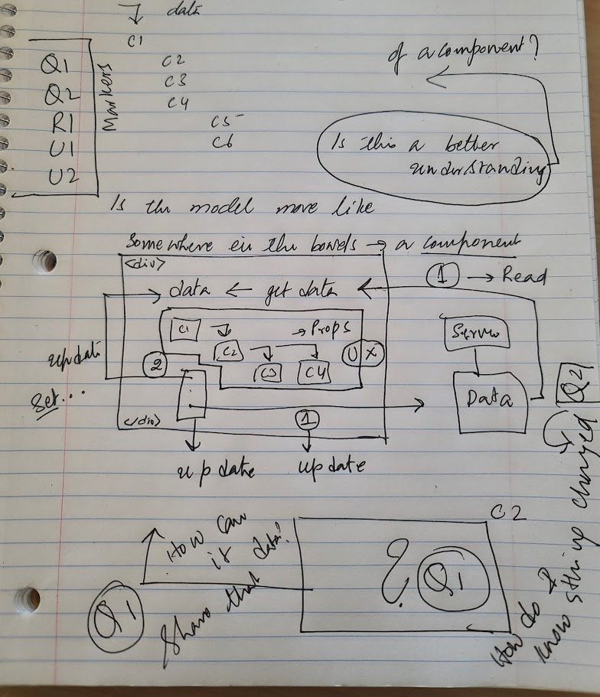
Component Model Details

Slide 5
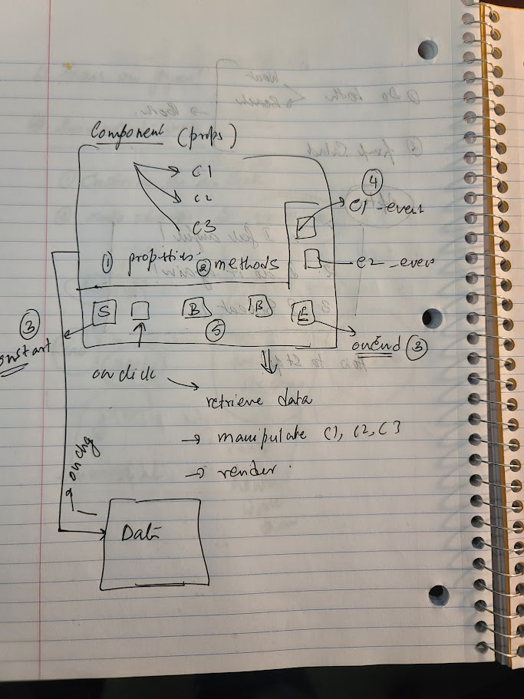
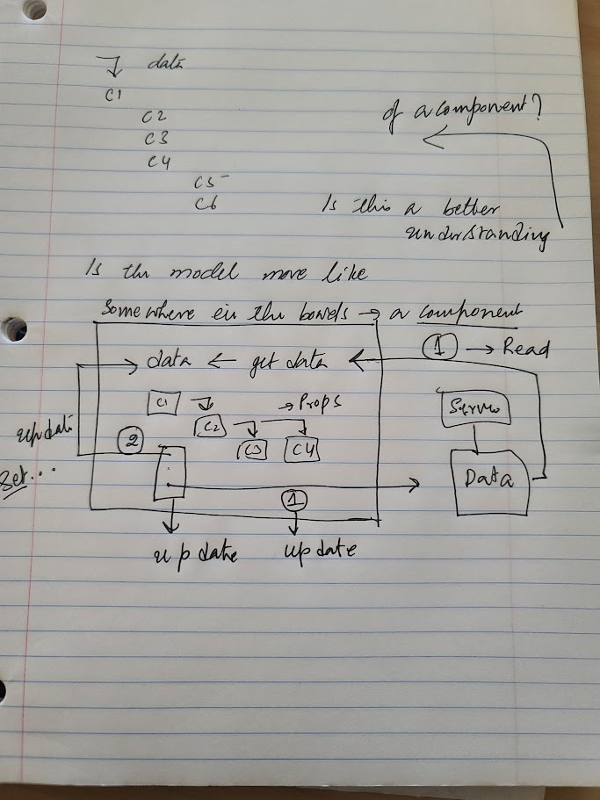
Strategic work

Slide 6
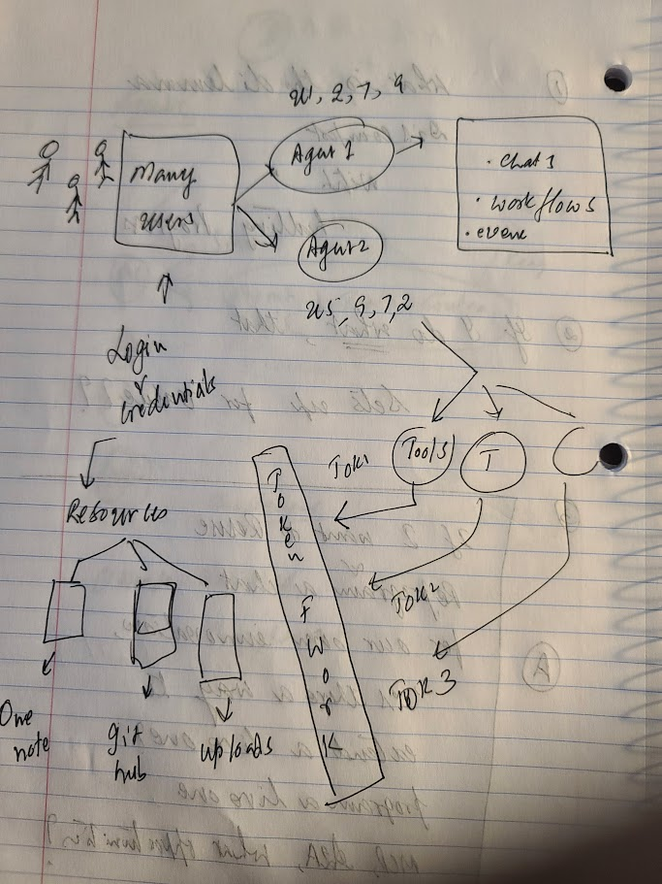
Strategic work

Slide 7
Key References

Slide 8
Key References: Libraries and Companies
# | Dt | Item | Description
1 | 6/21/25 | LangChain
 |  | Llama index
 |  | Hugging face
 |  | OpenAI
 |  | Assistant UI
 |  | Chroma DB
 |  | Crew AI
 |  | Google ADK
 |  | Google A2A

Slide 9
Appendix

Slide 10
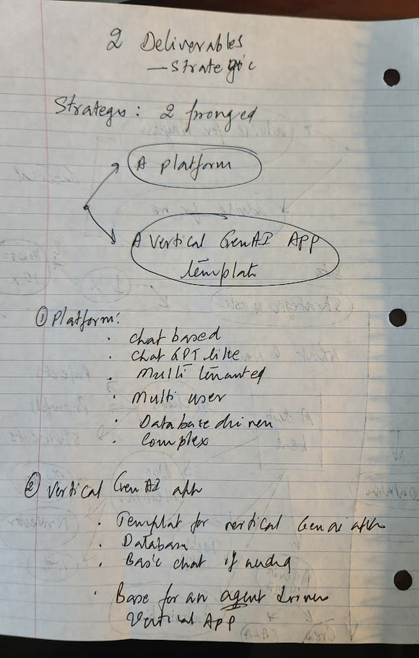
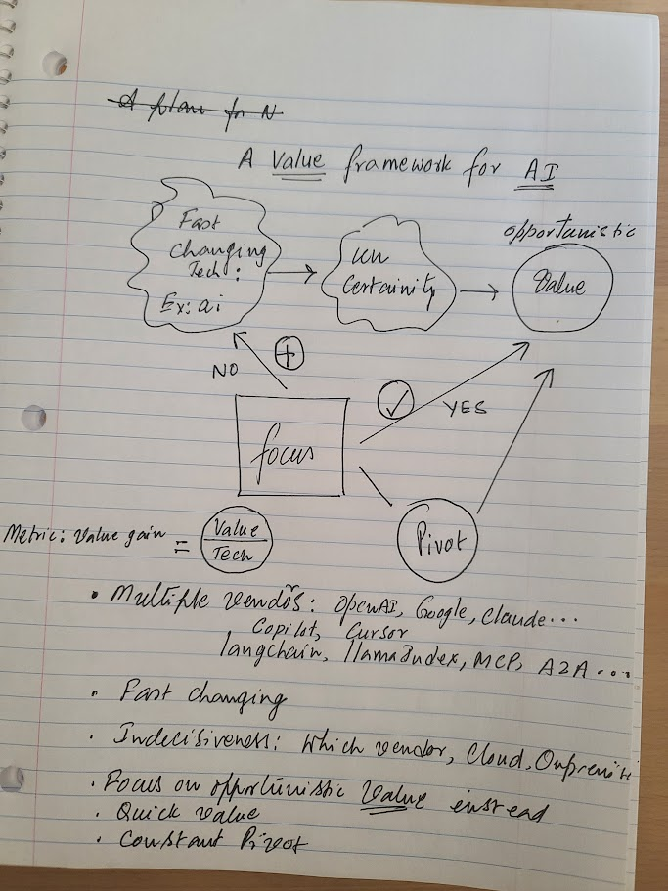
Strategic work

